Slide 1



Uncertainty quantification (UQ) for
chiral effective field theory
Dick Furnstahl
BSM Physics with Nucleons and Nuclei, July, 2020
Special thanks to my BUQEYE collaborators!
Notes:
Thanks to the organizers of this workshop for giving me an opportunities to tell you about how Bayesian statistical methods work well
In the application of effective field theories.
Thanks to BUQEYE collaborators. Bayesian Uncertainty Quantification: Errors for your EFT
And to funding agencies..

Slide 2
Preview of take-away points
Bayesian statistics is a powerful framework for (chiral) EFT uncertainty quantification (UQ). Everything is a pdf.

Slide 3
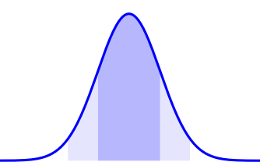
Preview of take-away points
Bayesian statistics is a powerful framework for (chiral) EFT uncertainty quantification (UQ). Everything is a pdf.

Slide 4
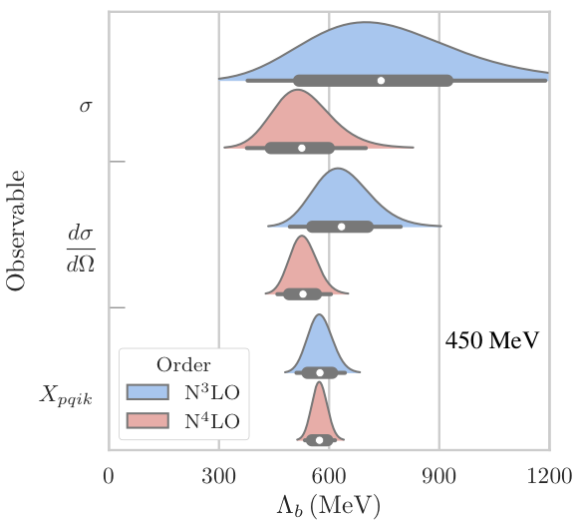
Preview of take-away points
Bayesian statistics is a powerful framework for (chiral) EFT uncertainty quantification (UQ). Everything is a pdf.
3P0 channel at N3LO, np sector
pr(Λ_{b} | y_{th}, I) ⇒ pdf of breakdown scale of EFT expansion
pr(θ | y_{exp} , Σ_{exp} , Σ_{th} , I) ⇒
pdf of model parameters θ given data y_{exp} and experiment/theory errors Σ
pr(δy_{th} |y_{th} , I) ⇒ pdf of theory error δy_{th} given theory calculations y_{th}
Naturalness prior!

Slide 5
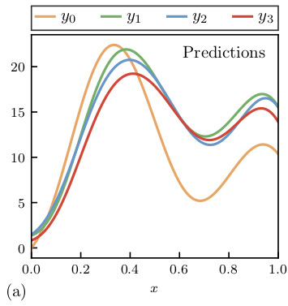
Preview of take-away points
Bayesian statistics is a powerful framework for (chiral) EFT uncertainty quantification (UQ). Everything is a pdf.
EFT theory discrepancy model from the convergence pattern and naturalness priors; assumptions explicit.
Model checking is an essential part of Bayesian UQ.
Order-by-order failure
Order-by-order success
Toy model for an observable y(x); e.g., cross section vs. energy, order-by-order in EFT.

Slide 6
Preview of take-away points
Bayesian statistics is a powerful framework for (chiral) EFT uncertainty quantification (UQ). Everything is a pdf.
EFT theory discrepancy model from the convergence pattern and naturalness priors; assumptions explicit.
Model checking is an essential part of Bayesian UQ.
Correlations matter (in many ways). Gaussian process truncation error model for continuous correlations.

Slide 7
Preview of take-away points
1S0 channel at N3LO
np sector
Bayesian statistics is a powerful framework for (chiral) EFT uncertainty quantification (UQ). Everything is a pdf.
EFT theory discrepancy model from the convergence pattern and naturalness priors; assumptions explicit.
Model checking is an essential part of Bayesian UQ.
Correlations matter (in many ways). Gaussian process truncation error model for continuous correlations.
Bayesian: sample for parameter estimation and the propagation of uncertainties; use emulators (like EC)!
Using priors and truncation errors minimizes overfitting and dependence on how much data is used; posteriors can be used for diagnostics.
3P0 channel at N3LO np sector
Wesolowski et al., J. Phys. G (2019)
pr(θ | y_{exp} , Σ_{exp} , Σ_{th} , I) ⇒
pdf of model parameters θ given data y_{exp} and experiment/theory errors Σ
Xilin Zhang S@INT talk on eigenvector continuation (EC) for scattering on August 13.

Slide 8
Preview of take-away points
Bayesian statistics is a powerful framework for (chiral) EFT uncertainty quantification (UQ). Everything is a pdf.
EFT theory discrepancy model from the convergence pattern and naturalness priors; assumptions explicit.
Model checking is an essential part of Bayesian UQ.
Correlations matter (in many ways). Gaussian process truncation error model for continuous correlations.
Bayesian: sample for parameter estimation and the propagation of uncertainties; use emulators (like EC)!
Using priors and truncation errors minimizes overfitting and dependence on how much data is used; posteriors can be used for diagnostics.
Model mixing is a frontier. Can we use RG invariance?
Gaute Hagen’s talk on 17-Jul-2020

Slide 9
BUQEYE Collaboration (“Bayesian Uncertainty Quantification: Errors for Your EFT”)
Christian Drischler
Dick Furnstahl
Harald Grießhammer
Natalie Klco
Jordan Melendez
Daniel Phillips
Matt Pratola
Sarah Wesolowski
Xilin Zhang
https://buqeye.github.io
The buckeye is the state tree of Ohio!
Papers and software (including Jupyter notebooks for figures)
Prehistory: INT program in 2003: Theories of Nuclear Forces and Nuclear Systems M. Schindler + D. Phillips, Bayesian Methods for Parameter Estimation in EFTs (2008-9) Ohio U. and Ohio State U. revive Bayesian EFT in 2014 → BUQEYE!
Recent highlight: “Effective Field Theory Truncation Errors and Why They Matter,” Jordan Melendez PhD thesis (2020)

Slide 10
Types of theory error
Uncertainty from numerical method
Truncation of Hilbert space (e.g., lattice volume/spacing or ho model space)
Model discrepancy (“All models are wrong, but some are useful” – George Box)
Incomplete or in parts incorrect physical model
Effective field theory expansion truncation error
Mostly systematic and correlated (doesn’t mean they can’t be treated as random!).
Systematic: error is not reduced when more observations are averaged
Correlated: e.g., model error in binding energy for oxygen chain all in same direction
Bayesian statistics is ideal for modeling, combining, and propagating theory errors!

Slide 11
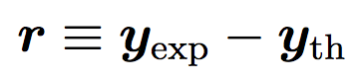
Two ways to treat the theory model discrepancy
Statistical model for observable y:
Advice from statisticians: any model for theory discrepancy is better than no model!
1. Model the distribution of residuals:
(δy_{exp})_{n} is often a Gaussian with mean μ = 0 and variance σ_{n}²: error bars size σ_{n}
For δy_{th}, look at pattern of residuals and model it (uncorrelated or correlated).
2. For effective field theories (EFT), learn from convergence pattern
Expect that each order will roughly improve by expansion parameter Q < 1:
Treat the c_{n}s as random variables and learn their distribution from calculated orders
Theory at order k:
Omitted orders:

Slide 12
Precursors of Bayesian EFT truncation error modeling
EFT expectations for expansions (cf. using cutoff dependence)
Pionless EFT [e.g, McGovern, Grießhammer, Phillips (2013); many others]
Epelbaum, Krebs, Meißner, EPJA (2015)
Perturbative QCD expansions [Cacciari and Houdeau, JHEP 1109 (2011) 039]
Bayesian error estimates using convergence pattern rather than scale dependence
Recent: M. Bonvini, arXiv:2006.16293
Toy model for an observable y(x); e.g., cross section vs. energy, order-by-order in EFT.
Bayesian approach formalizes the EFT expectations → statistical; model checking

Slide 13
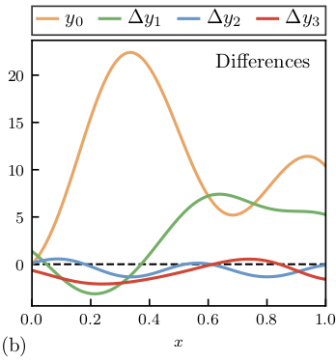
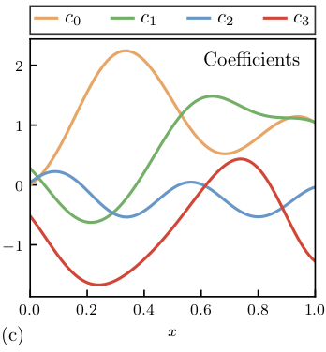
Coefficients for Bayesian EFT truncation model (not LECs!)
Order-by-order predictions of y:
Focus on differences: → rescale by reference and Q^{n} :
Treat c_{n}s (not LECs!!) as random variables and learn from calculated orders
→
Assumption: behavior of c_{n}s persists across orders with characteristic size (natural)
Notes:
\newcommand{\yvec}{y}
\yvec_{\rm th}(x) = \yvec_{0} + \yvec_{1} + \cdots + \yvec_{k}
\chi{\rm EFT} \Rightarrow Q = \frac{\{p,m_\pi\}}{\Lambda_b}, \quad \Lambda_b \approx 600\,{\rm MeV}

Slide 14
at order k

Slide 15
at order k

Slide 16
at order k

Slide 17
at order k

Slide 18
at order k

Slide 19
at order k

Slide 20
Tests of priors show insensitivity to details beyond leading orders → use flexible conjugate priors:
at order k
All integrals done analytically; intuitive updating.

Slide 21
Note: If n_{c} ≫ 1, the posterior for y becomes a normal distribution.
From https://buqeye.github.io/

Slide 22
Convergence pattern example from NN observables
J. Melendez et al. PRC (2017)

Slide 23
Effect of including truncation errors in parameter estimation
If effects of higher-order operators are absorbed by including theory errors, LEC extractions should be independent of E_{max}, the highest-energy datum used:
Uncorrelated assumption
Correlated assumption
Wesolowski et al., J. Phys. G (2019)

Slide 24
Bayesian applications by LENPIC
Analytic Bayesian DOB intervals based on Melendez et al., PRC 96, (2017); cheatsheet at https://buqeye.github.io/
http://www.lenpic.org/
Observables for elastic nucleon-deuteron scattering at 135 MeV.
Filin et al., Extraction of the neutron charge radius from a precision calculation of the deuteron structure radius, arXiv:1911.04877, PRL (2020).
Colored band is 68% Bayes credible interval for truncation error from convergence pattern.
Epelbaum et al, Towards high-order calculations of three-nucleon scattering in chiral effective field theory, arXiv:1907.03608, EPJA 56, 92 (2020).
SMS potentials + consistent 3N
68%/95% bands for Nd obs.
Also: prior sensitivity tests
Error analysis → will need ≥N⁴LO 3N forces for Nd
Notes:
\begin{align*}
y(p) &= y_{\textrm{ref}}(p)(c_0 + c_2 Q^2 + c_3 Q^3 + \cdots) \\
%
Q &= \max\left( \frac{p}{\Lambda_b}, \frac{M_\pi^{\textrm eff}}{\Lambda_b} \right)
\quad \Lambda_b = 600\mbox{--}700\,\mbox{MeV}\\
%
\Longrightarrow&\mbox{\ Analytic posterior for\ }\pr(\delta y_{\rm th}(p) \mid \{c_{i\leq k}\})
\end{align*}

Slide 25
Model Checking I: Weather plots (empirical coverage)
Order-by-order failure
Validates statistical model and EFT breakdown scale
Order-by-order success
Test of EKM NN chiral EFT potentials from Melendez et al., PRC 96, 024003 (2017)
In progress (2020): similar analysis of other NN interactions
Notes:
Melendez, Furnstahl, Wesolowski, PRC, 2017 after Furnstahl, Klco, DP, Wesolowski, PRC, 2015 after Bagnaschi, Cacciari, Guffanti, Jenniches, 2015

Slide 26
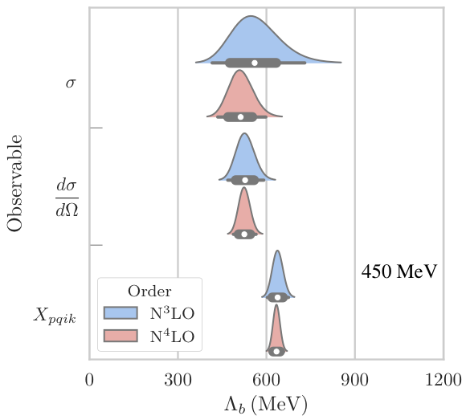
What is the breakdown scale of our effective field theory (EFT)?
Chiral EFT relies on an expansion parameter Q ~ {p, m_{π}} / Λ_{b}
But what is the breakdown scale Λ_{b} (where the terms are all the same)?
We promote Λ_{b} to a random variable with a posterior pdf (Bayesian!)
This posterior is predicted as a byproduct of the δy_{th} estimation.
Posteriors from NN observables at many more energies/angles; correlations?
Posteriors from NN observables at separated energies/angles (independent)
Melendez et al., PRC (2017), PRC (2019), and in preparation (2020)

Slide 27
Reminder about statistical correlations
pr(x, y | z) “joint probability (density) of x and y given z” (contingent on z)
With two points x and y, -1 ≤ ρ ≤ 1 → correlation. With many points x₁, x₂, … x_{N}, all pairs have a ρ_{ij} correlation to be learned.
Notes:
\mathcal{N}e^{-\frac12 \mathbf{r}^{\intercal}{\color{red}\Sigma^{-1}}\mathbf{r}}
&= \mathcal{N} e^{-\frac{(x-\mu)^2}{2\sigma_x^2}} e^{-\frac{(y-\mu)^2}{2\sigma_y^2}}
\\
\mathbf{r} = \begin{bmatrix} x \\ y \end{bmatrix} &
\qquad
{\color{red}\Sigma = \begin{bmatrix} \sigma_x^2 & 0 \\
0 & \sigma_y^2
\end{bmatrix}}
\mathcal{N}e^{-\frac12 \mathbf{r}^{\intercal}{\color{red}\Sigma^{-1}}\mathbf{r}}
&= \mbox{correlated gaussian}
% = \mathcal{N} e^{-\frac{(x-\mu)^2}{2\sigma^2}} e^{-\frac{(y-\mu)^2}{2\sigma^2}}
\\
\mathbf{r} = \begin{bmatrix} x \\ y \end{bmatrix}
\qquad &
{\color{red}\Sigma = \begin{bmatrix} \sigma_x^2 & \rho\sigma_x\sigma_y \\
\rho\sigma_x\sigma_y & \sigma_y^2
\end{bmatrix}}

Slide 28
Correlations with nearby points: Gaussian processes (GPs)
Start with a correlated Gaussian with two points x and y, where -1 ≤ ρ ≤ 1 gives correlation. Now imagine many points x₁, x₂, … x_{N} all of which have a ρ_{ij} correlation given by a function.
Interpolation
Regression
Pointwise c_{i}s vs. GP with learned c and l
J. Melendez et al., PRC (2019)

Slide 29
Correlated theory errors for infinite matter (arXiv:2004.07232, 2004.07805)
See Christian Drischler S@INT talk (May 28, 2020)
Neutron star
What are the constraints on the infinite matter equation of state from microscopic calculations, accounting for correlations?
[Also see Drischler et al. (2017, 2019); Gandolfi et al. (2019), Lonardoni et al. (2019), …]

Slide 30
Correlated theory errors for infinite matter
Christian Drischler, Jordan Melendez, rjf, Daniel Phillips (arXiv:2004.07805)
NN potential: Entem-Machleidt-Nosyk (450/500 MeV) with 3N LECs fitted to saturation
Apply many-body perturbation theory at each order in χEFT.
Learn hyperparameters for GPs from coefficient functions.
Propagate uncertainties for derivative quantities (with GPs).
Model checking tests how well the GP model works.
Find posteriors for breakdown scale
See Melendez et al., PRC (2019)
Notes:
Add a picture of the original source

Slide 31
Correlated theory errors for EOS properties
C. Drischler et al. (arXiv:2004.07232)
at 0.17 ± 0.01 fm³
Correlated GP treatment gives better estimates for truncation errors and clean propagation of uncertainties to derived quantities.
See also comparisons to GW and NICER posteriors!

Slide 32
Slide 17 from Gaute Hagen’s talk on 17-Jul-2020
Experience from SRG running: soft potentials → factorization works very well → matrix element ≈ scale independent → ≈ 0 eigenvalue (?)
Treat as Bayesian model mixing? Rather than model selection, combine the predictions of all. Use RG invariance to model δy_{th}?
Implied model for discrepancy δy_{th}: contact term plus independent Gaussian noise with same σ, correlated through [M^{0ν}]_{a}.

Slide 33
Recap of take-away points
Bayesian statistics is a powerful framework for (chiral) EFT uncertainty quantification (UQ). Everything is a pdf.
EFT theory discrepancy model from the convergence pattern and naturalness priors; assumptions explicit.
Model checking is an essential part of Bayesian UQ.
Correlations matter (in many ways). Gaussian process truncation error model for continuous correlations.
Bayesian: sample for parameter estimation and the propagation of uncertainties; use emulators (like EC)!
Using priors and truncation errors minimizes overfitting and dependence on how much data is used; posteriors can be used for diagnostics.
Model mixing is a frontier. Can we use RG invariance?
https://buqeye.github.io
Papers and software (including Jupyter notebook for figures)
New and coming soon: experimental design; EC for scattering; constraints on 3BF LECs; analysis of NN forces; exploiting correlations in nuclei.

Slide 34
Extra slides

Slide 35
Summary: ingredients of EFTs that invite Bayesian statistics
Choice of degrees of freedom and organization (“power counting”)
Well-defined order-by-order construction used to predict observables ⇒ truncation error
Short distance physics is encoded in low-energy constants (LECs) that need to be fitted
Expectation is that observables improve as powers of a small parameter (e.g., ratios of scales) that may not be well determined
Need to validate the EFT and provide robust theory error bars
Bayesian approach: (almost) everything is a probability density function (pdf)!
Use rules of probability to manipulate.
Marginalize over nuisance parameters.
Notes:
There are differences in detail between EFTs, but there are shared ingredients that are inviting for applying Bayesian methods.
In the hierarchy here there are multiple opportunities for EFTs; for example, later I will mention collective models.
For every successful nuclear phenomenology there is the possibility of an EFT and fleshing them out is a frontier activity.
Let’s step through the ingredients:
Choice: model selection to help decide. Here we’ll use nucleon dofs, but with a pion or without? What Feynman diagrams contribute at each order?
Truncation error: Bayesian model is well suited
Parameter estimation: Low energy constants (or LECs) from experimental or computational data
Discovery: extracting physics
Model checking: validate your EFT and its implementation.
To the Bayesian mindset, (almost) everything is a probability density function (pdf). Examples:
pr(\theta | D,I) \propto pr(D | \theta, I) pr(\theta | I) updating your knowledge (including explicit expectations)
pr(EFT_1 | D,I) / pr(EFT_2 | D,I)
pr(y, x | )
Introduce “nuisance” parameters for things and marginalize over them.
\documentclass[10pt]{article}
\usepackage[usenames]{color} %used for font color
\usepackage{amssymb} %maths
\usepackage{amsmath} %maths
\usepackage[utf8]{inputenc} %useful to type directly diacritic characters
\usepackage{bm}
\newcommand{\pr}{\textsf{pr}}
\newcommand{\yexp}{\bm{y}_{\textsf exp}}
&\pr(\textsf{EFT}_1 \mid \yexp, I) / \pr(\textsf{EFT}_2 \mid \yexp, I) \\
&\qquad\qquad\ \Longrightarrow\ \textsf{evidence ratio given data} \\[12pt]
&\pr(\{c_n\} \mid \bm{\theta}, I) \ \Longrightarrow\ \textsf{pdf of expansion coefficients}\\[12pt]
&{\color[rgb]{0.986246,0.007121,0.027434}\pr(\bm{\theta} \mid \yexp, \Sigma_{\textsf{exp}}, I) \propto \pr(\yexp \mid \bm{\theta}, \Sigma_{\textsf{exp}}, I)\, \pr(\bm{\theta}\mid I)} \\
&\quad {\color[rgb]{0.986246,0.007121,0.027434}\ \Longrightarrow\ \textsf{pdf of LECs given data\ } \yexp, \Sigma_{\textsf{exp}}\ (\textsf{and\ } \Sigma_{\textsf{th}}!)} \\[12pt]
&\pr(\Lambda_b\mid \bm{\theta}, I) \ \Longrightarrow\ \textsf{pdf of EFT breakdown scale} \\[12pt]
&\pr(\mu, \sigma \mid I) \ \Longrightarrow\ \textsf{pdf of hyperparameters} \\

Slide 36
State of knowledge as probability distributions (pdfs)
pr(A, B | C) “joint probability (density) of A and B given C” (contingent on C)
A, B, C can be observables, parameters, uncertainties, propositions, models, …
cf. quantum mechanics |ψ(x, y)|² or |ψ(x)|² = ∫ |ψ(x, y)|² dy (marginalization)
Bayesian confidence (credible) interval:
Pr(θ | y_{exp} , Σ_{exp} , Σ_{th} , I) ⇒
pdf of model parameters θ given data y_{exp} and experiment/theory errors Σ, plus other information I
Examples of pdfs for theory UQ:
Notes:
\mathcal{N}e^{-\frac12 \mathbf{r}^{\intercal}{\color{red}\Sigma^{-1}}\mathbf{r}}
&= \mathcal{N} e^{-\frac{(x-\mu)^2}{2\sigma_x^2}} e^{-\frac{(y-\mu)^2}{2\sigma_y^2}}
\\
\mathbf{r} = \begin{bmatrix} x \\ y \end{bmatrix} &
\qquad
{\color{red}\Sigma = \begin{bmatrix} \sigma_x^2 & 0 \\
0 & \sigma_y^2
\end{bmatrix}}
\mathcal{N}e^{-\frac12 \mathbf{r}^{\intercal}{\color{red}\Sigma^{-1}}\mathbf{r}}
&= \mbox{correlated gaussian}
% = \mathcal{N} e^{-\frac{(x-\mu)^2}{2\sigma^2}} e^{-\frac{(y-\mu)^2}{2\sigma^2}}
\\
\mathbf{r} = \begin{bmatrix} x \\ y \end{bmatrix}
\qquad &
{\color{red}\Sigma = \begin{bmatrix} \sigma_x^2 & \rho\sigma_x\sigma_y \\
\rho\sigma_x\sigma_y & \sigma_y^2
\end{bmatrix}}

Slide 37
Bayes’s Theorem: How to update knowledge in PDFs
Likelihood overwhelms prior
Prior suppresses unconstrained likelihood
Notes:
Add likelihood example as overlay
\usepackage{bm}
\DeclareMathOperator{\pr}{\text{pr}} % Good, but want to handle sizing and | spacing?
{\color{red}\pr(A|B,I)} = \frac{{\color{blue}\pr(B|A,I)} {\color[rgb]{0.000000,0.493151,0.000000}\pr(A|I)}}{\pr(B|A)}
\Longrightarrow
{\color{red}\underbrace{\pr(\bm{\theta} | \mathbf{y}_{\rm exp}, I)}_{\mbox{\scriptsize posterior}}}
\propto
{\color{blue}\underbrace{\pr(\mathbf{y}_{\rm exp} | \bm{\theta}, I)}_{\mbox{\scriptsize likelihood}}}
\times
{\color[rgb]{0.000000,0.493151,0.000000}\underbrace{\pr(\bm{\theta} | I)}_{\mbox{\scriptsize prior}}}
{\color{red}\pr(A|B,I)} = \frac{{\color{blue}\pr(B|A,I)} {\color[rgb]{0.000000,0.493151,0.000000}\pr(A|I)}}{\pr(B|A)}
\Longrightarrow
{\color{red}\underbrace{\pr(x | \mbox{data}, I)}_{\mbox{posterior}}}
\propto
{\color{blue}\underbrace{\pr(\mbox{data} | x, I)}_{\mbox{likelihood}}}
\times
{\color[rgb]{0.000000,0.493151,0.000000}\underbrace{\pr(\mbox{data} | I)}_{\mbox{prior}}}
{\color{red}\pr(\bm{\theta} | \mathrm{y}_{\rm exp}, \Sigma_{\rm exp}, \Sigma_{\rm th}, I)}
\propto {\color{blue}e^{-\frac12 \mathbf{r}^{\intercal}(\Sigma_{\rm exp}+\Sigma_{\rm th})^{-1}\mathbf{r}}}
\times {\color[rgb]{0.000000,0.493151,0.000000} e^{-\bm{\theta}^2/2\bar\theta} }
\usepackage{bm}
\newcommand{\pr}{\text{pr}}
&{\color{blue}
%\mbox{likelihood: }
\pr(\mathbf{y}_{\rm exp} | \bm{\theta}, I) \propto e^{-\chi^2/2}
}
\quad\underset{\rm uncorrelated}{\Longrightarrow}\quad
{\color{blue}
\chi^2 = \sum_i^{\rm data} \mathbf{r}_i\frac{1}{\sigma_i^2}\mathbf{r}_i \;,
\quad
\mathbf{r} \equiv \mathbf{y}_{\rm exp} - \mathbf{y}_{\rm th}(\bm{\theta})
} \\[10pt]
&\quad\mbox{correlated: }
{\color{red}\pr(\bm{\theta} | \mathrm{y}_{\rm exp}, \Sigma_{\rm exp}, \Sigma_{\rm th}, I)}
\propto {\color{blue}e^{-\frac12 \mathbf{r}^{\intercal}(\Sigma_{\rm exp}+\Sigma_{\rm th})^{-1}\mathbf{r}}} \times {\color[rgb]{0.000000,0.493151,0.000000} e^{-\bm{\theta}^2/2\bar\theta^2} }
&{\color{blue}
%\mbox{likelihood: }
\pr(\mathbf{y}_{\rm exp} | \bm{\theta}, I) \propto e^{-\chi^2/2}
}
\quad\underset{\rm uncorrelated}{\Longrightarrow}\quad
{\color{blue}
\chi^2 = \sum_i^{\rm data} \mathbf{r}_i\frac{1}{\sigma_i^2}\mathbf{r}_i \;,
\quad
\mathbf{r} \equiv \mathbf{y}_{\rm exp} - \mathbf{y}_{\rm th}(\bm{\theta})
} \\[10pt]
&\quad\mbox{correlated: }
{\color{red}\pr(\bm{\theta} | \mathrm{y}_{\rm exp}, \Sigma_{\rm exp}, \Sigma_{\rm th}, I)}
\propto {\color{blue}e^{-\frac12 \mathbf{r}^{\intercal}(\Sigma_{\rm exp}+\Sigma_{\rm th})^{-1}\mathbf{r}}} \times {\color[rgb]{0.000000,0.493151,0.000000} e^{-\bm{\theta}^2/2\bar\theta^2} }

Slide 38
Parameter estimation: Exploring projected posteriors
First without the model discrepancy (theory error) term:
Consider high-enough order so that truncation error is small
Regular least-squares (𝜒²) likelihood times Gaussian prior for natural LECs:
Residual:
Discourages large LECs (naturalness)
Notes:
\newcommand{\bm}[1]{\boldsymbol{#1}}
\newcommand{\genobs}{\bm{y}}
\newcommand{\pr}{\text{pr}}
\newcommand{\avec}{\vec{a}}
\pr(\avec_k|\genobs_{\text{exp}},\Sigma_{\text{exp}}) \propto \pr(\genobs_{\text{exp}}|\avec_k, \Sigma_{\text{exp}})\ \pr(\avec_k)
\propto e^{-\resvec^T\Sigma_{\text{exp}}^{-1} \resvec} \times e^{-(\avec_k)^2/2\abar^2}

Slide 39
Projected posteriors as a diagnostic tool
Projected posteriors give:
info on correlations
“best” parameter values
indication of normality
Uncorrelated and Gaussian
Also: Comparison to EKM’s values from optimization
(need not match!)
3P0 channel at N3LO
np sector

Slide 40
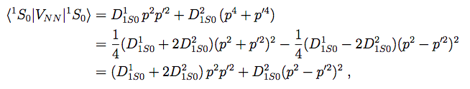
Projected posteriors as a diagnostic tool
1S0 channel at N3LO
np sector
Irregular structure of posterior
Nothing necessarily wrong, but a clue
Here: a physics issue actually explains the distorted structure
Parameter redundancy at N3LO, an operator can be eliminated
True in 3S1-3D1 channel as well
Wesolowski et al., J. Phys. G (2019)

Slide 41
Projected posteriors as a diagnostic tool
1S0 channel at N3LO
np sector
Set to 0 and use only 3 parameters
Description of data still good (and potential softer)
Reinert et al., EPJA (2018) improved potential
Wesolowski et al., J. Phys. G (2019)

Slide 42
Effect of the prior with less data
Wesolowski et al., J. Phys. G (2019)
Repeat same problem, vary givens
Increase prior width
Less data, prior needed to avoid overfitting
Increase range of data, prior has less influence
Increase E_{max} (more data at higher energy)

Slide 43
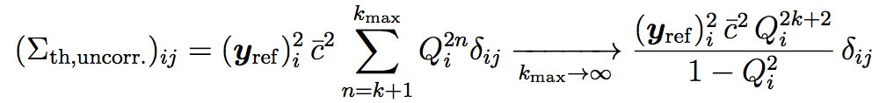
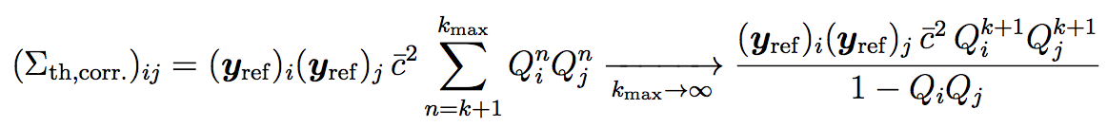
Parameter estimation including truncation errors
Full posterior pdf including theory error:
Covariance matrix for assuming uncorrelated Q points:
Covariance matrix assuming fully correlated Q points:
Wesolowski et al., J. Phys. G (2019)

Slide 44
Bayes is great, but won’t the sampling be too expensive?
Dilemma: Bayesian sampling of posteriors is desirable, but modern nuclear theory calculations typically require supercomputer resources.
Solution: Emulators! Train a computer model of the calculation using a representative set of parameters and then sample from the model instead.
Gaussian process emulators: think about efficient interpolations formulas, but with error estimates. Eigenvector continuation: use a really effective variational basis (introduced for physics applications by Frame et al., PRL 121 (2018)).
Notes:
\documentclass[10pt]{article}
\usepackage[usenames]{color} %used for font color
\usepackage{amssymb} %maths
\usepackage{amsmath} %maths
\usepackage[utf8]{inputenc} %useful to type directly diacritic characters
\usepackage{bm}
\newcommand{\design}{{\color{blue}\mathbf{d}}}
\DeclareMathOperator*{\argmax}{arg\,max}
\newcommand{\shrinkage}{\mathcal{S}}
\newcommand{\omegalab}{\omega_{\text{lab}}}
\newcommand{\given}{\,|\,} % Use for | in \pr
%\DeclareMathOperator{\pr}{pr} % Good, but want to handle sizing and | spacing?
\DeclareMathOperator{\pr}{p} % Good, but want to handle sizing and | spacing?
% Now add spacing:
% Derivatives
\newcommand{\dd}{d}
\newcommand{\diffcs}{d\sigma} % differential cross section
\newcommand{\genobs}{y}
\newcommand{\genobsset}{{\color{green}\inputvec{\genobs}}}
\newcommand{\inputvec}{\mathbf}
\newcommand{\lecs}{{\color{red}\vec{a}}}
\newcommand{\alphavec}{\bm{\theta}}
&\mbox{Calculate $i = 1 \mbox{ to } N$ ground-state wfs: } \widehat H(\alphavec_i) |\psi_0(\alphavec_i) \rangle = E_0(\alphavec_i) |\psi_0(\alphavec_i) \rangle, \\
&\mbox{Use trial wavefunction from linear combination of $|\psi_0(\alphavec_i) \rangle$s: } \\
&{\color[rgb]{0.986246,0.007121,0.027434} \quad |\psi_{\text{trial}}\rangle = c_1 |\psi_0(\alphavec_1)\rangle + c_2 |\psi_0(\alphavec_2)\rangle + \cdots + c_N |\psi_0(\alphavec_N)\rangle} \\
&\mbox{Minimize $\langle \psi_{\text{trial}}| \widehat H(\alphavec) |\psi_{\text{trial}}\rangle$ with $\langle \psi_{\text{trial}}| \psi_{\text{trial}}\rangle = 1$ to find $E_0(\alphavec)$ and $c_i$s }

Slide 45
Bayes is great, but won’t the sampling be too expensive?
Eigenvector Continuation as an Efficient and Accurate Emulator
for Uncertainty Quantification
arXiv:1909.08446
based on Frame et al.,
PRL 121 (2018))
S. König, A. Ekström, K. Hebeler, D. Lee, A. Schwenk
⁴He energy
⁴He energy

Slide 46
Bayes is great, but won’t the sampling be too expensive?
Global sensitivity analysis of bulk properties of an atomic nucleus
arXiv: 1910.02922
A. Ekström and G. Hagen
“We have to use (16 + 1) · 216 = 1,114,112 quasi MC samples to extract statistically significant main and total effects of the energy and radius for all LECs. With SP-CC(64) this took about 1 hour on a standard laptop, while an equivalent set of exact CCSD computations would require 20 years."

Slide 47
Gaussian process model of the coefficients

